Slide 1

PROJECT NAME:
NAME:N.NAVYA
REG NO:22AJ1A4736

Slide 2
ONLINE CODE EDITOR
NAME:N.NAVYA
REG NO:22AJ1A4736
BRANCH:CIC

Slide 3
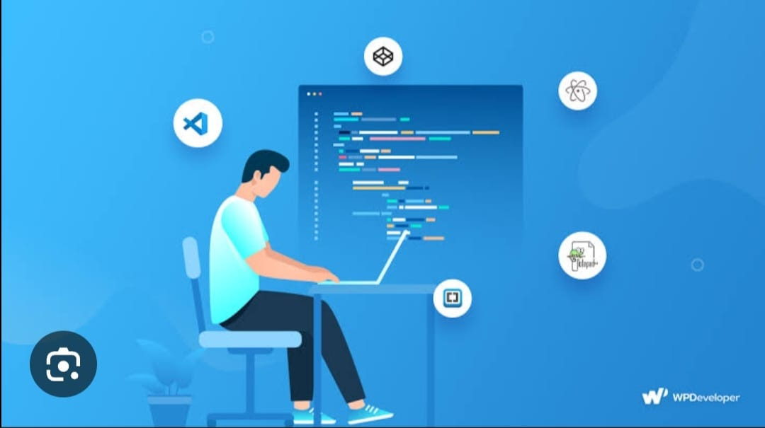
ABSTRACT:
An online code editor is a web-based platform that allows developers to write, edit, and debug code directly within a web browser. This convenience eliminates the need for local software installations and ensures accessibility from any device with internet connectivity. The primary objective of this system is to provide a robust, user-friendly environment for coding that supports multiple programming languages and integrates seamlessly with various development tools and services. The online code editor is designed to enhance productivity, facilitate collaboration, and streamline the coding process.

Slide 4
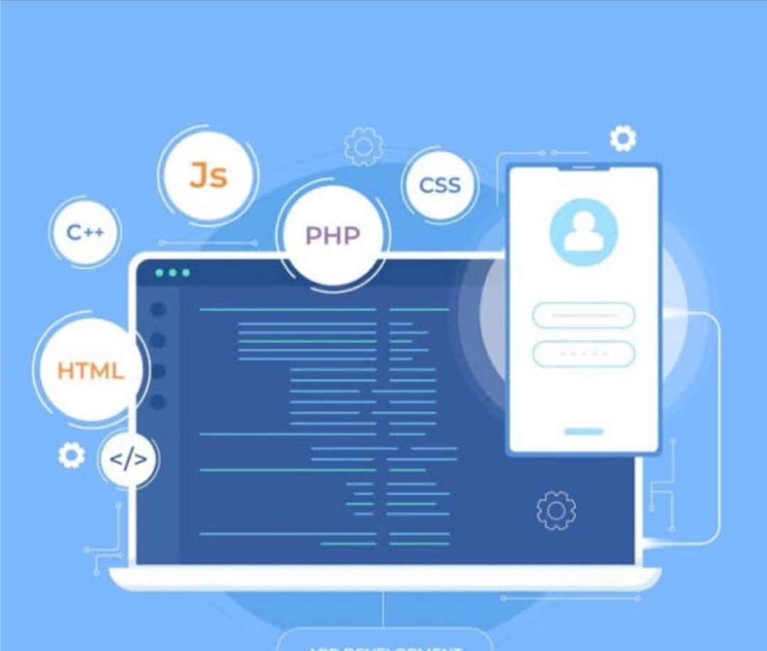
EXISTING SYSTEM:
CodePen
Overview: CodePen is an online code editor and social development environment primarily for front-end developers. It supports HTML, CSS, and JavaScript, allowing users to create and share code snippets, called "Pens."
Features: Real-time preview, live code sharing, community engagement, and integration with various libraries and frameworks.
Limitations: Limited backend support, which can restrict full-stack development and the ability to handle server-side code.

Slide 5
PROPOSED SYSTEM
PROPOSED SYSTEM:
The proposed online code editor aims to address the limitations of existing systems by offering a more comprehensive and integrated development experience. The key features and improvements include:
Multi-Language Support: Unlike existing systems that are often limited to specific languages, the proposed system will support a broader range of programming languages, including Python, JavaScript, C++, Java, and Ruby.
Advanced Collaboration Tools: Enhanced real-time collaboration features will include code reviews, pair programming, and chat functionalities to facilitate better teamwork and communication among developers.

Slide 6
SOFTWARE REQUIREMENTS
.Frontend Technologies:
HTML/CSS: For structuring and styling the editor's user interface.
JavaScript: For implementing interactive features and real-time updates.
Frameworks/Libraries: React or Angular for dynamic UI components; CodeMirror or Monaco Editor for code editing functionalities.

Slide 7
HARDWARE REQUIREMENTS:
Server Specifications:
Processor: Multi-core processors (e.g., Intel Xeon or AMD EPYC) for handling multiple concurrent users.
Memory: Minimum 16GB RAM, scalable based on user load and application complexity.
Storage: SSDs with sufficient capacity to store user data, code snippets, and application logs.
Network: High-speed internet connectivity with load balancing and failover capabilities to ensure uptime and reliability.

Slide 8
ADVANTAGES
Advantages:
Learning Opportunity:
Full-Stack Development: You’ll gain experience in both front-end and back-end development.
Understanding Web Technologies: Working with APIs, databases, and frameworks enhances your tech stack knowledge.
Real-Time Collaboration:
Multi-User Functionality: Implementing features for multiple users can teach you about WebSockets and real-time data handling.

Slide 9
DISADVANTAGES
Complexity:
Technical Challenges: Building a fully functional code editor can be overwhelming, especially for beginners.
Time-Consuming:
Development Time: Depending on the features, this project can take significant time to complete.

Slide 10
CONCLUSION
The proposed online code editor represents a significant advancement over existing systems by offering a comprehensive, integrated environment that supports a wide range of programming languages, advanced collaboration tools, and scalable backend support. By addressing the limitations of current solutions and incorporating features designed to enhance productivity and collaboration, this editor aims to provide developers with a powerful tool for modern software development. With careful attention to software and hardware requirements, the proposed system will deliver a robust and efficient platform that meets the needs of both individual developers and teams working on complex projects.

Slide 11
THANK YOU

